Slide 1

REQUIREMENT GATHERING

Slide 2
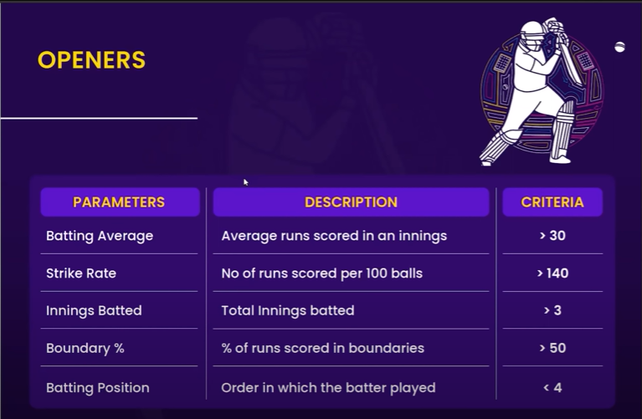
OPENERS

Slide 3
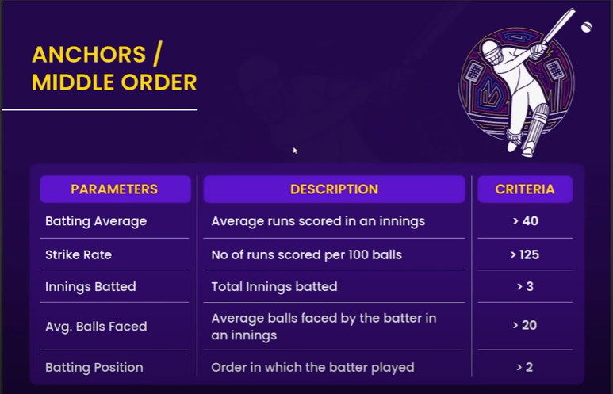
MIDDLE ORDER

Slide 4
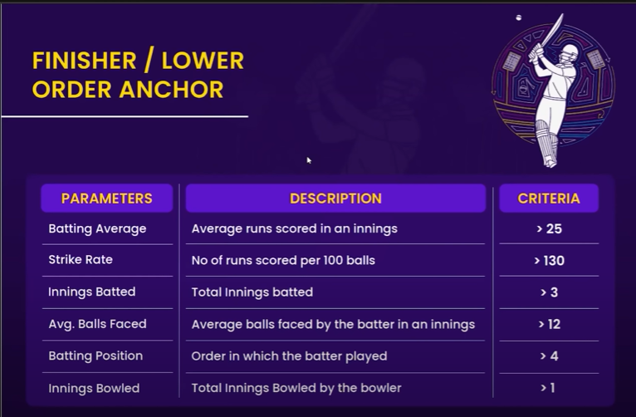
FINISHER

Slide 5
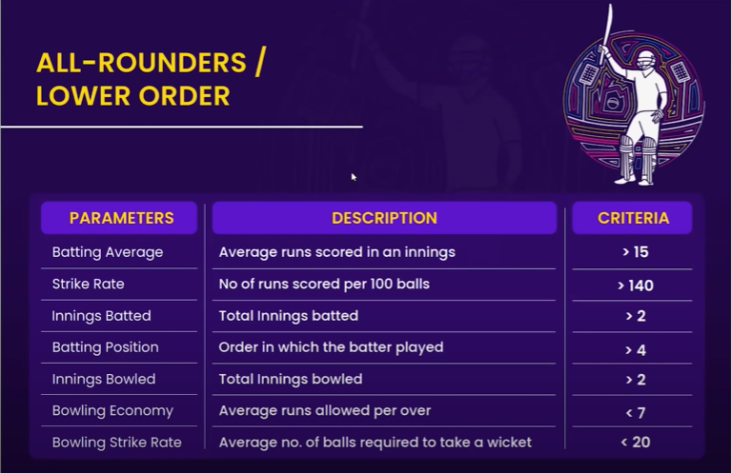
ALL ROUNDERS

Slide 6
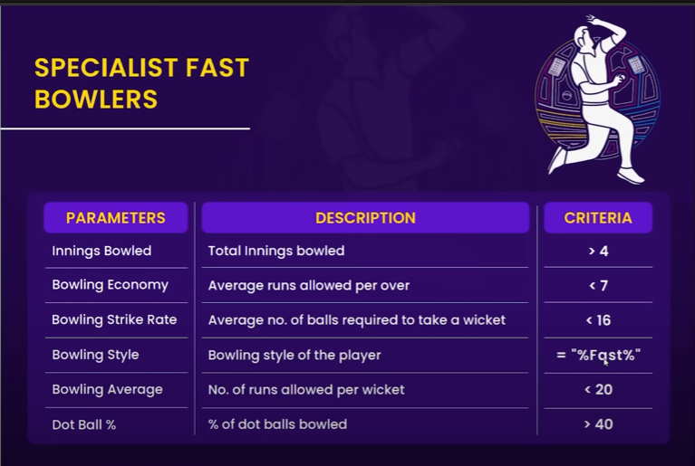
BOWLERS

